Slide 1
Data Analytics
K-Means Clustering

Slide 2
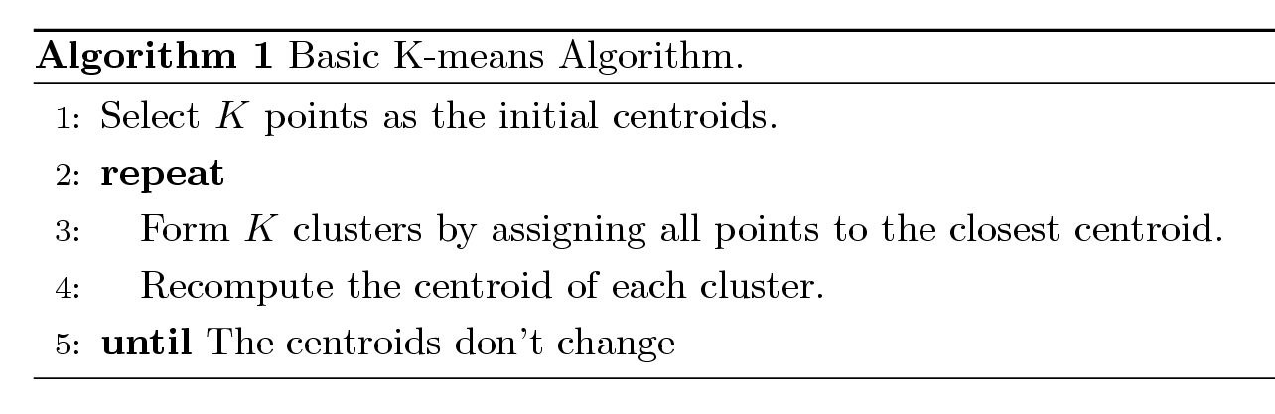
K-means Clustering
Partitional clustering approach
Number of clusters, K, must be specified
Each cluster is associated with a centroid (center point)
Each point is assigned to the cluster with the closest centroid
The basic algorithm is very simple

Slide 3
Example of K-means Clustering

Slide 4
Example of K-means Clustering

Slide 5
K-means Clustering – Details
Initial centroids are often chosen randomly.
Clusters produced vary from one run to another.
Centroid is the mean of points in the cluster.
‘Closeness’ is measured by Euclidean distance, cosine similarity, correlation, etc.
K-means will converge for common similarity measures mentioned above.
Most convergence happens in the first few iterations.
Often the stopping condition is changed to ‘Until relatively few points change clusters’
Complexity is O( n * K * I * d )
n = number of points, K = number of clusters, I = number of iterations, d = number of attributes

Slide 6
K-means Clustering – R
Department for Transport Road Safety Data
https://data.gov.uk/dataset/cb7ae6f0-4be6-4935-9277-47e5ce24a11f/road-safety-data
Vehicles involved in accidents
Are there clusters of vehicles involved in accidents in terms of age of driver and age of vehicle?
226,409 cases in dataset
152,601 have data for both ages of driver and vehicle

Slide 7
K-means Clustering – R
R code
load("VehicleData2018.RData")
summary(Veh2018$Age_of_Driver)
Min. 1st Qu. Median Mean 3rd Qu. Max. NA's
1.00 28.00 38.00 40.89 52.00 101.00 29016
summary(Veh2018$Age_of_Vehicle)
Min. 1st Qu. Median Mean 3rd Qu. Max. NA's
1.00 4.00 8.00 8.12 12.00 84.00 59369
Age of driver is more varied than age of vehicle
One unit change for vehicle is more important than one unit change for driver
To overcome this, we can standardise the data (using “scale” command in R)

Slide 8
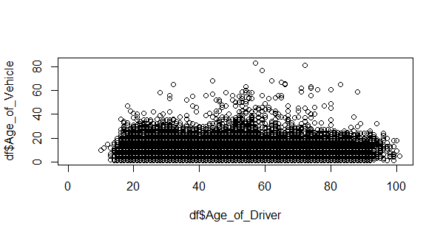
K-means Clustering – R
R code
#create dataframe
df<-Veh2018[,c("Age_of_Driver","Age_of_Vehicle")]
#plot data
plot(df$Age_of_Driver,df$Age_of_Vehicle)
#do kmeans analysis for 2 clusters
km2.out<-kmeans(scale(df),2)
Error in do_one(nmeth) : NA/NaN/Inf in foreign function call (arg 1)

Slide 9
K-means Clustering – R
R code
#create dataframe with only complete cases
df<-df[complete.cases(df),]
#do kmeans analysis for 2 clusters
km2.out<-kmeans(scale(df),2)
km2.out$size
[1] 84991 67610
km2.out$centers
Age_of_Driver Age_of_Vehicle
1 0.007503867 -0.7380879
2 -0.009432941 0.9278336

Slide 10
Evaluating K-means Clusters
Most common measure is Sum of Squared Error (SSE)
For each point, the error is the distance to the nearest cluster
To get SSE, we square these errors and sum them.
x is a data point in cluster C_{i} and m_{i} is the representative point for cluster C_{i}
Can show that m_{i} corresponds to the center (mean) of the cluster
Given two sets of clusters, we prefer the one with the smallest error
One easy way to reduce SSE is to increase K, the number of clusters
A good clustering with smaller K can have a lower SSE than a poor clustering with higher K

Slide 11
K-means Clustering – R
R code
km2.out<-kmeans(scale(df),2)
km2.out$tot.withinss [200,648.55]
km3.out<-kmeans(scale(df),3)
km3.out$tot.withinss [124,986.18]
To carry on, let us automate things
set.seed(2021) #initialising so we can repeat
km.tot.withinss<-NA #initialise storage
#loop from 2 to 20 clusters
for (i in 2:20){
km.out<-kmeans(scale(df),i)
km.tot.withinss[i]<-km.out$tot.withinss
}

Slide 12
K-means Clustering – R
R code
km.tot.withinss
[1] NA 200684.55 124986.18 93511.36 79171.88
[6] 68741.48 58724.65 51748.01 47669.44 41627.46
[11] 38466.69 35103.29 32261.45 30112.36 28328.37
[16] 26955.37 25271.92 24028.04 23277.32 21421.82
diff(km.tot.withinss)
[1] NA -75698.3762 -31474.8185 -14339.4767
[5] -10430.4042 -10016.8222 -6976.6476 -4078.5665
[9] -6041.9797 -3160.7745 -3363.3942 -2841.8424
[13] -2149.0874 -1783.9935 -1373.0026 -1683.4429
[17] -1243.8791 -750.7238 -1855.5033
Stop at 10 cluster solution
Reduction in SS smaller after this step

Slide 13
K-means Clustering – R
R code
km.out<-kmeans(df,10)
km.out$size
[1] 9136 8495 20067 24054 19368 21075 17664
[8] 19699 1126 11917
km.out$centers
Age_of_Driver Age_of_Vehicle
1 1.81529007 0.938075095
2 1.95234611 -0.676317797
3 -0.85737908 -0.008711258
4 -0.86501484 1.043752595
5 -0.09119878 -0.917169317
6 -0.98691325 -0.965040292
7 0.83113042 -0.891987072
8 0.38541096 0.258601312
9 0.21411113 4.000437500
10 0.41063773 1.384810672

Slide 14
K-means Clustering – R
R code
aggregate(df,by=list(cluster=km.out$cluster),mean)
cluster Age_of_Driver Age_of_Vehicle
1 1 71.35355 13.081546
2 2 73.61754 4.456622
3 3 27.20442 8.023322
4 4 27.07828 13.646130
5 5 39.86075 3.169868
6 6 25.06467 2.914116
7 7 55.09647 3.304404
8 8 47.73374 9.451444
9 9 44.90409 29.442274
10 10 48.15046 15.468239
Draw conclusions and implement policies as a result

Slide 15
K-means Clustering – R
Exercise
With the same Department for Transport Road Safety Data, undertake a cluster analysis using K-means using the variables “Age_of_Driver” and “Engine_Capacity_.CC.”
Adapt code in the file “K-Means Clustering - class session code.R”
Try a range of numbers of clusters
Decide which number of clusters is best
Create summary statistics

Slide 16
Two different K-means Clusterings
Original Points
Optimal Clustering
Sub-optimal Clustering

Slide 17
Limitations of K-means
K-means has problems when clusters are of differing
Sizes
Densities
Non-globular shapes
K-means has problems when the data contains outliers

Slide 18
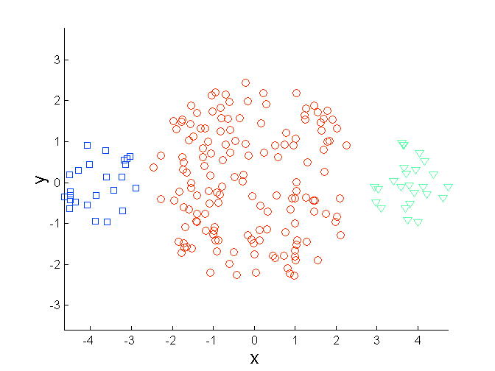
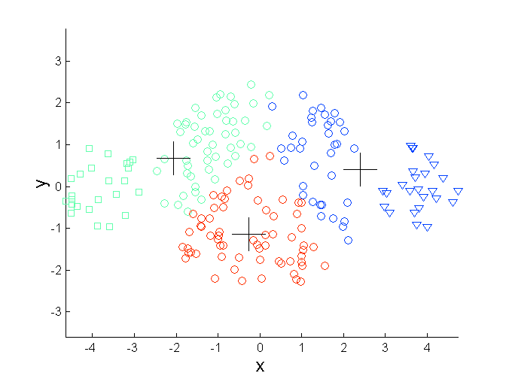
K-means Limitations: Differing Sizes
Original Points
K-means (3 Clusters)

Slide 19
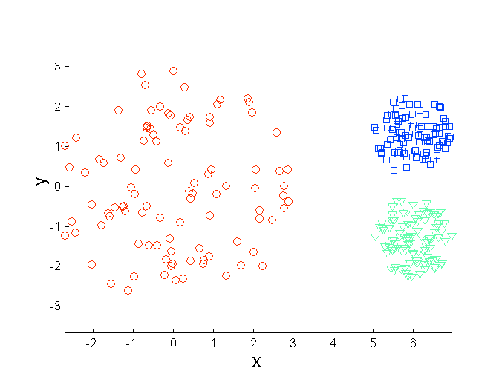
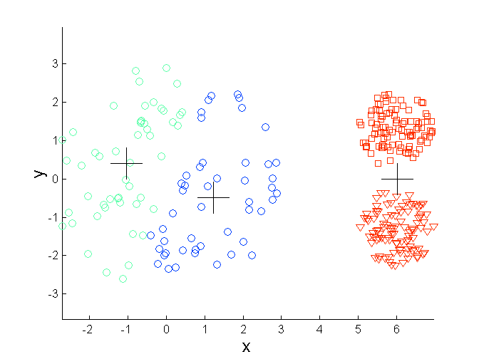
K-means Limitations: Differing Density
Original Points
K-means (3 Clusters)

Slide 20
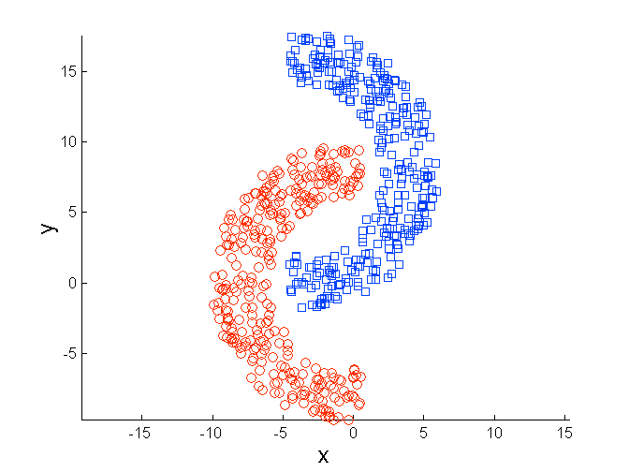
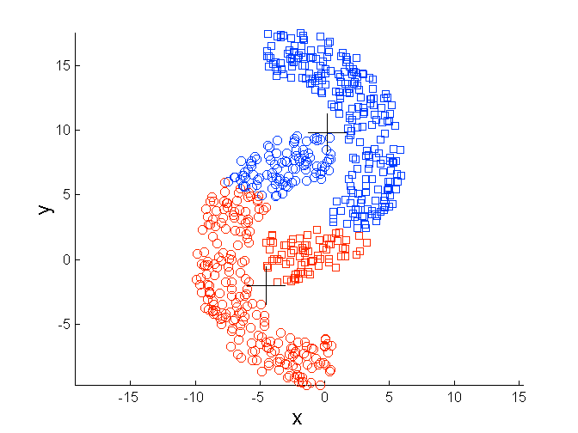
K-means Limitations: Non-globular shapes
Original Points
K-means (2 Clusters)

Slide 21
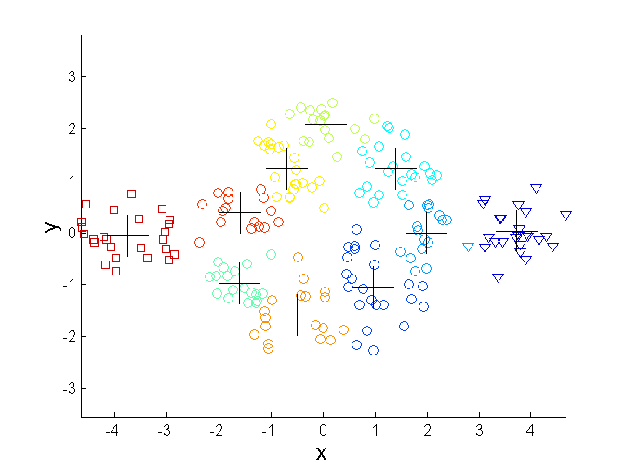
Overcoming K-means Limitations
One solution is to use many clusters
Find parts of clusters, but need to put together
Original Points
K-means Clusters

Slide 22
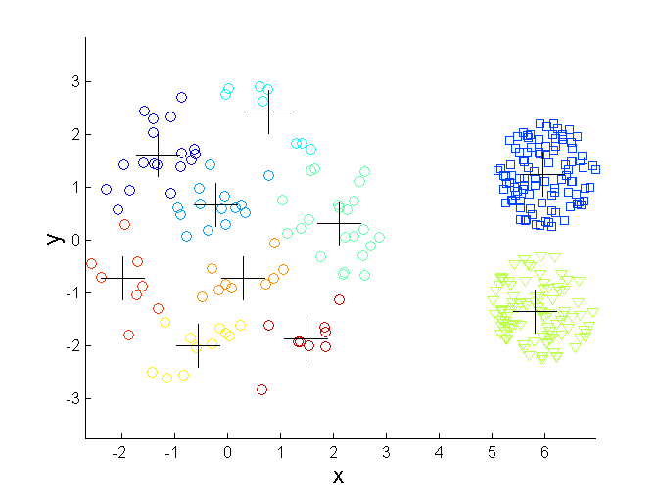
Overcoming K-means Limitations
Original Points
K-means Clusters

Slide 23
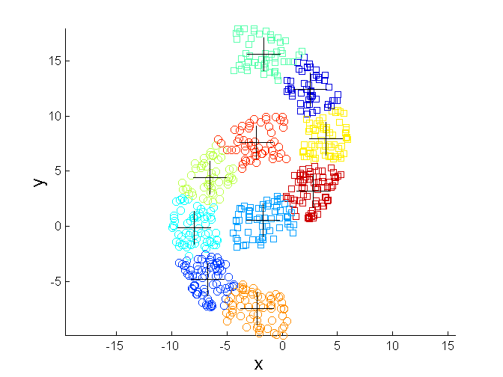
Overcoming K-means Limitations
Original Points
K-means Clusters

Slide 24
Importance of Choosing Initial Centroids

Slide 25
Importance of Choosing Initial Centroids

Slide 26
Importance of Choosing Initial Centroids

Slide 27
Importance of Choosing Initial Centroids

